Slide 1
American Legion Department of Michigan
Financial Reporting & Compliance
Training

Slide 2
Session 1
BASIC
POST FINANCES

Slide 3

Agenda
What is Compliance?
New Post Start-up
Legal Organization of Post
Applications Required
LARA – If organizing as a Corporation
EIN
Tax Exempt – 501(c)(19)
Michigan Sales Tax
Annual Filing Requirements Overview
990
LARA
Post Officer Insurance
Change in Post Management

Slide 4

Compliance
To be in Compliance, a Post must submit ALL Federal and State mandated Applications and Reports on a timely basis, as required by their individual circumstances. This also includes providing National with the Post’s EIN via the Judge Advocate Letter, so the Post will be included in The American Legion’s Group Exemption Letter.

Slide 5
Formation of a New Post
Apply for Charter
Decide Legal Organization of Post
Charitable Organization (Not a Corporation)
Corporation
Submit Articles of Incorporation to Michigan Department of Licensing & Regulatory Affairs (LARA), Corporations Division
Annual Fee Required
May Require Legal Assistance
LARA Filing has NOTHING to do with your Tax Exempt Status

Slide 6

The Basics
Apply for EIN (Tax ID Number)
Mail or Fax IRS Form SS-4
https://www.irs.gov/pub/irs-pdf/fss4.pdf
Apply On-line
https://www.irs.gov/businesses/small-businesses-self-employed/apply-for-an-employer-identification-number-ein-online
Indicate Type of Entity
Corporation
Other Nonprofit Organization (Not a Corporation)

Slide 7
Become Tax Exempt
What is a 501(c)(19) Organization?
A post, Organization, Auxiliary Unit, etc., of past or present members of the Armed Forces of the United States
Contributors may be able to deduct contributions to your Post from their Income Taxes
No Income Tax liability on income generated from the nonprofit activities of the Post (Fundraisers, etc.)
If Post owns Real Property, may be exempt from paying Property Taxes in Michigan
Exempt from Paying Sales Tax on items purchased for charitable purposes

Slide 8
501(c)(19)…
Must be operated exclusively for one or more of the following purposes:
To promote the social welfare of the community (e.g., to promote the common good and general welfare of the people of the community)
To assist disabled and needy war veterans and members of the United States Armed Forces and their dependents - and the widows and orphans of deceased veterans
To provide entertainment, care, and assistance to hospitalized veterans or members of the United States Armed Forces
To carry on programs to perpetuate the memory of deceased veterans and members of the United States Armed Forces and comfort their survivors
To conduct programs for religious, charitable, scientific, literary or educational purposes
To sponsor or participate in activities of a patriotic nature
To provide insurance benefits for members or their dependents or
To provide social and recreational activities for members

Slide 9
Become Tax Exempt
Easy Method
Submit Judge Advocate’s Letter to National Headquarters to include the Post’s EIN in the Group Exemption Letter
Once included in Group Exemption Letter, IRS will classify the Post as a 501(c)(19) as a subordinate of National
http://michiganlegion.org/finances---taxes.html

Slide 10
Become Tax Exempt
Painful Method
Complete IRS Form 1024 (Application for Recognition of Exemption OMB No. 1545-0057 Under Section 501(a))
Requires substantial time, effort, and documentation to complete
Submitter must pay at least $600 User Fee
May take multiple attempts and substantial amount of time
Not Guaranteed

Slide 11
Become Tax Exempt
Lazy Method (Not Recommended)
Do not Follow Easy or Painful Method
After a number of years, based on the name of the organization, the IRS MAY recognize the Post as a 501(c) organization of their choice – not necessarily a 501(c)(19)
IRS probably will not inform you of this decision
If the Post doesn’t know, they probably will NOT submit their Annual Filings, and will lose their Tax Exempt Status
Must follow Painful Method to be Reinstated

Slide 12
Bank Account
Open a Bank Account
Charitable Organization
May use EIN, or SSN of one of the Signers
Recommend NOT using SSN
Corporation
Must use EIN
Usually have to provide copy of Articles of Incorporation

Slide 13
Michigan Sales Tax on SALES
Individuals or businesses that SELL tangible personal property to the final consumer are required to remit a 6% sales tax on the total price of their taxable retail sales to the State of Michigan
Examples
Prepared Food intended for Immediate Consumption
Sales of Alcoholic Beverages
Sales of Merchandise

Slide 14
Michigan Sales Tax
Exceptions
Casual Sales
Sale of a refrigerator the Post no longer has a need for
Unprepared Food item Sales

Slide 15
Fundraising Events - Exemption
(3) Except as otherwise limited under this subsection, the sale of tangible personal property by a veterans' organization that is exempt from federal income tax under section 501(c)(19) of the internal revenue code, 26 USC 501, for the purpose of raising funds for the benefit of an active duty service member or a veteran is exempt from the tax under this act. ………continued

Slide 16
Fundraising Events - Exemption
The exemption under this subsection is limited to $25,000.00 in aggregate sales of tangible personal property for each individual fund-raising event. A club, association, auxiliary, or other organization affiliated with a veterans' organization that is exempt from federal income tax under section 501(c)(19) of the internal revenue code, 26 USC 501, is not considered a separate person for purposes of this exemption.

Slide 17
Michigan Sales Tax on PURCHASES
Michigan Public Act 530 (2018)
(1) A sale of tangible personal property not for resale to the following, subject to subsection (5), is exempt from the tax under this act:
An organization not operated for profit and exempt from federal income tax under section 501(c)(19) of the internal revenue code, 26 USC 501.

Slide 18
Michigan Sales Tax on PURCHASES
Michigan Public Act 530 (2018) Cont…
The exemptions provided for in subsection (1) do not apply to any of the following:
Sales of tangible personal property or vehicles used for purposes of raising funds or obtaining resources if the sales price exceeds the following:
For an organization exempt under subsection 501(c)(19) $25,000.00.

Slide 19
Michigan Sales Tax on PURCHASES
The tangible personal property under subsection (1) is exempt only to the extent that the property is used to carry out the purposes of the organization or to raise funds or obtain resources necessary to carry out the purposes of the organization as stated in the organization’s bylaws or articles of incorporation.

Slide 20
Michigan Sales Tax on PURCHASES
(5)The exemption for any single item of tangible personal property or vehicle used to raise funds or obtain resources is limited to a sales price that does not exceed $5,000.00 for an organization exempt under subsection (1)(a) or (b) (501(c)(3) or 501(c)(4)) and $25,000.00 for an organization exempt under subsection (1)(c (501(c)(19))

Slide 21
Michigan Sales Tax on PURCHASES
Michigan Public Act 530
Does NOT exempt purchases related to the regular business of the Post Home – The Bar

Slide 22
Annual Filing Requirements
IRS Form 990
Submit EVERY Year (Usually 15 May) to maintain Tax Exempt Status
Three Versions
990-N (e-postcard)
990-EZ
990
LARA Annual Report (Michigan)
Non-Profit Corporations ONLY
$20 Annual Fee
This filing has NOTHING to do with the Tax Exempt Status of your organization
990 Filing has EVERYTHING to do with maintaining the Tax Exempt Status of your organization

Slide 23
Blanket Bond (Insurance) Covering Post Officers
All Posts are required to bond (Insure) their officers handling Post funds
Positions Covered
Commander, Adjutant, Finance Officer
Coverage up to $2,500
Cost $10
Covers the DUES portion remitted to Department ONLY

Slide 24
Change in Post Management?
Change POC with:
IRS
Tax Exempt Customer Account Services (877) 829-5500
Business and Specialty Tax Line (EIN) (800) 829-4933
LARA
Corporations, Securities & Commercial Licensing Bureau (517) 241-6470 or CorpsMail@michigan.gov
MI Dept of Treasury – Sales & Use Tax
(517) 636-6925
Log onto Michigan Treasury Online (MTO)

Slide 25


End of Session 1

Slide 26
Session 2
INTERMEDIATE
POST FINANCES

Slide 27
Agenda
Annual Filing Requirement Details
IRS Form 990
LARA
How do we know if we’re in Compliance?
Verifying Compliance
Included in Group Exemption Letter?
LARA – Are we a Corporation?
What is our Tax Exempt Status?
Out of Compliance?
Solutions
Unrelated Business Income

Slide 28
Federal Reporting Requirements
IRS Form 990
Submit EVERY Year (Usually 15 May) to maintain Tax Exempt Status
990-N
e-postcard
990-EZ
Not as EZ as the name implies
990
Complex calculations required
Usually involves a Tax Professional

Slide 29
990-N
Form 990-N
E-Postcard – Came into existence in 2008
Changed Annual Reporting Requirements
EVERYONE must file some form of 990
Very little information required
Basic Organizational Information
Can be filed on-line
Gross Receipts normally less than or equal to $50,000 Average per year (Includes Dues)

Slide 30
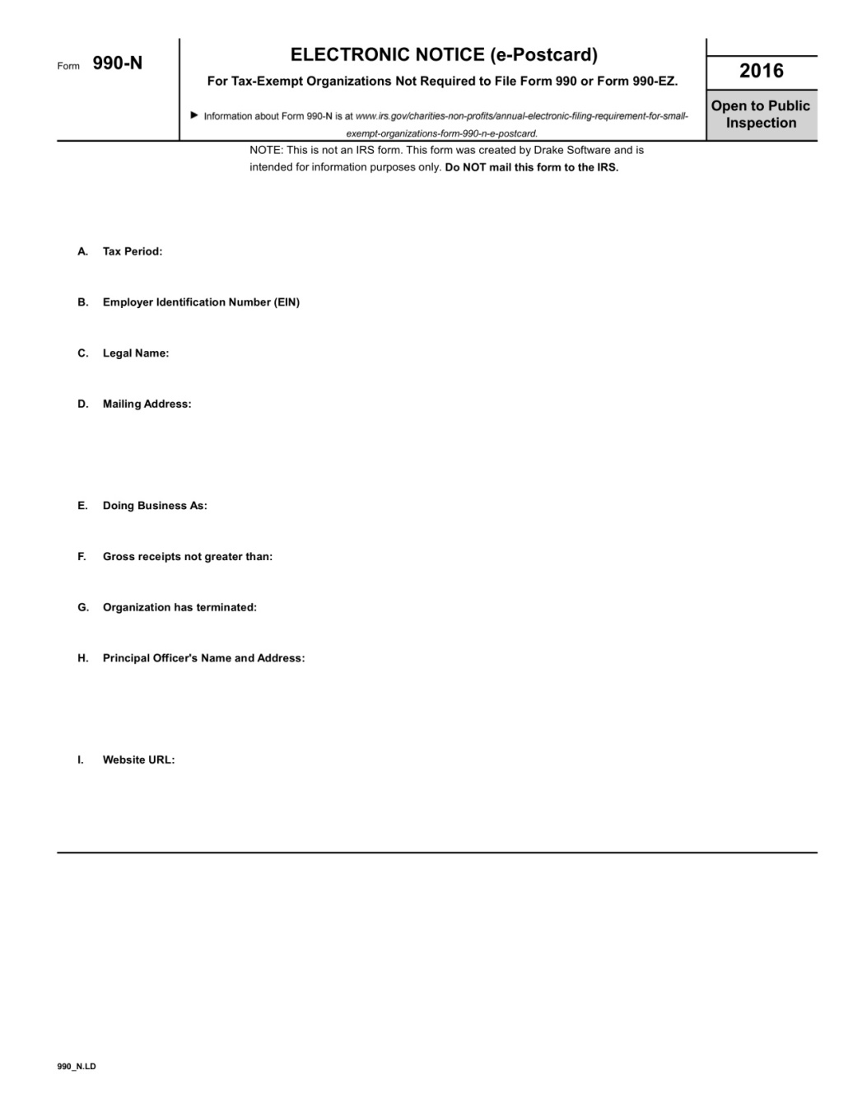

Slide 31
990-EZ
Form 990-EZ
Much more financial information required
Gross Receipts <$200,000 (Includes Dues) AND Total Assets <$500,000
May involve Tax Professional

Slide 32
990
Form 990
Great deal of detailed financial information required
Usually involves use of CPA or Tax Firm to prepare
Gross Receipts >/=$200,000 OR Total Assets >/=$500,000 (Includes Dues)

Slide 33
What happens if we DON’T File a 990?
Don’t file for three consecutive years, the IRS will Automatically Revoke your Post’s Tax Exempt Status
Donors will NOT be able to deduct contributions from their Income Taxes
Post will have to pay Income Tax on their profits
If a Corporation, Post will have to file Corporate Tax Return, Form 1120
If Post owns Real Property, would no longer be exempt from Property Taxes in Michigan

Slide 34
LARA Annual Report
Annual Reports for Nonprofit Corporations must be received by the Corporations Division by October 1
$20 Fee
If a corporation fails to submit their annual report or pay the related fee within two years of the due date of the report, the corporation automatically dissolves by operation of law

Slide 35
Are We in Compliance?
Included in National’s Group Exemption Letter?
http://www.michiganlegion.org/assets/einstatusforpostsasofsept2016.pdf
Inclusion in this Listing does NOT verify the status of your Tax Exempt Status
Exclusion from this listing does NOT necessarily mean your are not Tax Exempt

Slide 36
Are we a Corporation?
Search LARA
Online Entity Search
http://w1.lara.state.mi.us/businessentitysearch/
Contact LARA
Corporations Division P.O. Box 30054 Lansing, MI 48909
517-241-6470
CorpsMail@michigan.gov

Slide 37
What is our Tax Exempt Status?
Check your Post’s Tax Exempt Status Here
https://www.irs.gov/charities-non-profits/tax-exempt-organization-search
Four Choices of Databases to Search
Are Eligible to Receive Tax Deductible Contributions
Does NOT list subordinate Members of a Group Exemption Letter
Were Automatically Revoked
Have Filed Form 990-N
Exempt Organizations Business Master File

Slide 38

How do we get our Tax Exempt Status Reinstated?
If your Post’s Tax Exempt Status has been revoked, the IRS has a procedure in place to apply for reinstatement
Post is now on it’s own with the IRS
All the Judge Advocate’s Letters in the world won’t help

Slide 39
How do we get our Tax Exempt Status Reinstated?
Complete IRS Form 1024 (Application for Recognition of Exemption OMB No. 1545-0057 Under Section 501(a))
https://www.irs.gov/charities-non-profits/automatic-revocation-of-exemption
Requires substantial time, effort, and documentation to complete
Submitter must pay at least $600 User Fee
May take multiple attempts and substantial amount of time
Not Guaranteed

Slide 40
Unrelated Business Income
Even though an organization is recognized as tax exempt, it still may be liable for tax on its unrelated business income. For most organizations, unrelated business income is income from a trade or business, regularly carried on, that is not substantially related to the charitable, educational, or other purpose that is the basis of the organization's exempt purpose or function.

Slide 41
Unrelated Business Income
Regardless of the organization's need for income or funds, or the use it makes of the profits
An exempt organization that has $1,000 or more of gross income from an unrelated business must file Form 990-T

Slide 42
Exceptions to Unrelated Business Income Rules
Conducting any game of chance by a nonprofit organization in the state of North Dakota…..
Exception Does NOT Apply - We’re in MICHIGAN
Conducting a trade or business that consists of Bingo games

Slide 43

End of Session 2

Slide 44
Session 3
ADVANCED
POST FINANCES

Slide 45
Agenda
Q & A
Specific Post Situations & Inquiries

